Slide 1

DATA SCIENCE
10 WEEK PART TIME COURSE
Week 4 - Natural Language Processing

Slide 2
AGENDA
Natural Language Processing
Case Studies
Techniques for NLP
Lab
Discussion

Slide 3
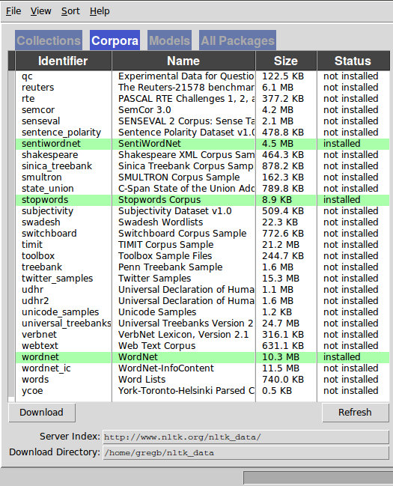
While Greg is talking
Make sure nltk is installed
(import nltk)
Run nltk.download()
Install the following Corpora
gutenberg
sentiwordnet
stopwords
wordnet
Install the following Models
punkt
averaged_perceptron_tagger
pip install textblob
pip install lda

Slide 4
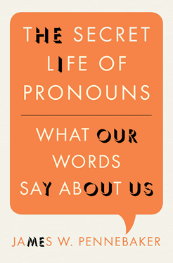
Greg’s Reading Suggestion
How Tweets and Facebook posts can tell us about the personality of their authors.
Why lying to others and to ourselves causes us to talk differently.
How it’s possible to predict if two people will fall in love by counting the function words the two people use in their first conversation with one another.
When we can predict a person’s age, sex, where they live, and what their background is by analyzing their conversations or emails.
Why self-confident leaders rarely use the word “I” and insecure and depressed people do.
How writing about an emotional upheaval using particular linguistic styles can help you get past it.
Why analyzing your own emails, letters, and natural conversations can tell you about yourself and the relationships you cherish most.

Slide 5
From text to features
DATA SCIENCE PART TIME COURSE

Slide 6
What Natural Language Processing looks like
Big blob of text
???
Features for a model

Slide 7
The goal
A dataframe
Each row is a document
Columns represent features
Do something with the dataframe:
Predict a column from the others?
Cluster documents?
Title | Number of words | Ratio of personal pronouns | Soliloquy to a skull
Alice in Wonder-land | 34110 | 0.1% | No
Hamlet | 37360 | 0.3% | Yes
Persuasion | 98171 | 0.7% | No

Slide 8
Methods
Compare against giant corpora
Count occurrences of words
Count occurrences of pairs and triples of words
Take ratios
Find word combinations that are probabilistically unusual
Parse sentences into nouns, verbs, adjectives
Chunk into noun phrases, etc.
A large and structured set of texts
e.g. the Brown Corpus, contains 500 samples of English- language text, totaling roughly one million words, compiled from works published in the United States in 1961

Slide 9
Why does this work even without understanding?
Spooky personality effects on writing
http://www.hackerfactor.com/GenderGuesser.php
There aren’t that many ways to say things
We personify / anthropomorphise
Shallow Understanding

Slide 10
Low-level Shallow Deep
Lexical parsing Morphological (word) segmentation Optical character recognition (OCR) Part-of-speech (POS) tagging Sentence boundary disambiguation Speech/phoneme segmentation | Automatic summarization Named entity recognition (NER) Sentiment analysis Speech recognition Topic segmentation and recognition Word sense disambiguation | Machine translation Natural language generation Natural language understanding

Slide 11
Python NLP Packages
 | Pros | Cons
NLTK: Natural Language Toolkit | Well-documented Active dev community Lots of features | Unsuitable for high-performance applications
Gensim: Topic Modeling for Humans | Built-in distributed computing support Can index datasets larger than RAM Great docs, tutorials | Narrow application focus Smaller support community (than NLTK)
Sklearn | Part of familiar set of tools for Machine Learning Good lib to explore small datasets | Limited set of NLP features “Blows up with memory errors much sooner than other libs”
corenlp: Wrapper for Stanford Core NLP | Stanford Core NLP ... Written in Java Gold standard for serious NLP work | Python wrapper around a package written in Java Relatively little support
Textblob (wrapper around NLTK) | Ease of use | Same as NLTK

Slide 12
Using NLTK
DATA SCIENCE PART TIME COURSE

Slide 13
Getting a document
Text = open(‘filename.txt’).read()
print nltk.corpus.gutenberg.fileids()
Alice = nltk.corpus.gutenberg.raw(‘carrol-alice.txt’)

Slide 14
WORD-SENTENCE SEGMENTATION
The standard approaches to locate the end of a sentence:
If it's a period, it ends a sentence
If the preceding token is in the hand-compiled list of abbreviations, then it doesn't end a sentence
But if the next token after an abbreviation is capitalized, then it ends a sentence.
This strategy gets about 95% of sentences correct.
(Source: Wikipedia)
It fails badly on Markdown documents. It needs a tuned segmenter for this.

Slide 15
NLTK does word and sentence segmentation
nltk.sent_tokenize(“This is a sentence. So is this.”)
nltk.corpus.gutenberg.sents(“carrol-alice.txt”)

Slide 16
Breaking up words
nltk.word_tokenize(“A single sentence.”)
[nltk.word_tokenize(s) for s in nltk.sent_tokenize(…)]

Slide 17
Lexical diversity
How many different words were used?
How many words in the whole text?
High ratio: rich, intelligent, challenging text
Low ratio: high redundancy, repetitious

Slide 18
Lexical diversity stability
Most authors have a steady level of lexical diversity in their writing
Uses:
Disputed authorship
Is a passage a quote from somewhere else

Slide 19
Mini-LAB Which has the longer average sentence: Alice in Wonderland or Emma? Which has the greater lexical diversity?
DATA SCIENCE PART TIME COURSE

Slide 20
Visualisation and concordancing
DATA SCIENCE PART TIME COURSE

Slide 21
NLTK Text Object
Construct a “Text” from a list of words
t = nltk.Text(nltk.word_tokenize(“Once upon a time …”))

Slide 22
Interesting Text object methods
Text.concordance(search_term)
Text.similar(search_term)
Text.common_contexts(search_terms)
Text.dispersion_plot(search_terms)

Slide 23
Mini-LAB How the authors used words
DATA SCIENCE PART TIME COURSE

Slide 24
Stemming, lemmatization, Synonyms
DATA SCIENCE PART TIME COURSE

Slide 25
STEMMING/ LEMMATIZATION
LinkedIn sees 6,000+ variations on the job title, “Software Engineer”
They see 8,000+ variations on the company, “IBM”
They have to recognize all of these and understand they are the same

Slide 26
STEMMING/ LEMMATIZATION
On a smaller scale, it is often useful to strip away conjugations and other modifiers:
science, scientist → scien
swim, swimming, swimmer → swim
The resulting text is often unreadable, but retains semantic content

Slide 27
Stemming methods
Snowball
import nltk.stem.snowball.SnowballStemmer
Stemmer = SnowballStemmer(“english”)
Stemmer.stem(“running”)
Porter
import nltk.stem.snowball.PorterStemmer
Stemmer = PorterStemmer(“english”)
Stemmer.stem(“running”)

Slide 28
WordNet synsets
import nltk.corpus.wordnet
S = wordnet.synsets(“car”)
print [x.lemma_names() for x in S]
print [x.definition() for x in S]
Parent_Concepts = S[0].hypernyms()
Child_Concepts = S[0].hyponyms()
Synset1.lower_common_hypernyms(Synset2)
Synset1.path_similarity(Synset2)

Slide 29
Mini-LAB How the authors used words
DATA SCIENCE PART TIME COURSE

Slide 30
Part of Speech Tagging
DATA SCIENCE PART TIME COURSE

Slide 31
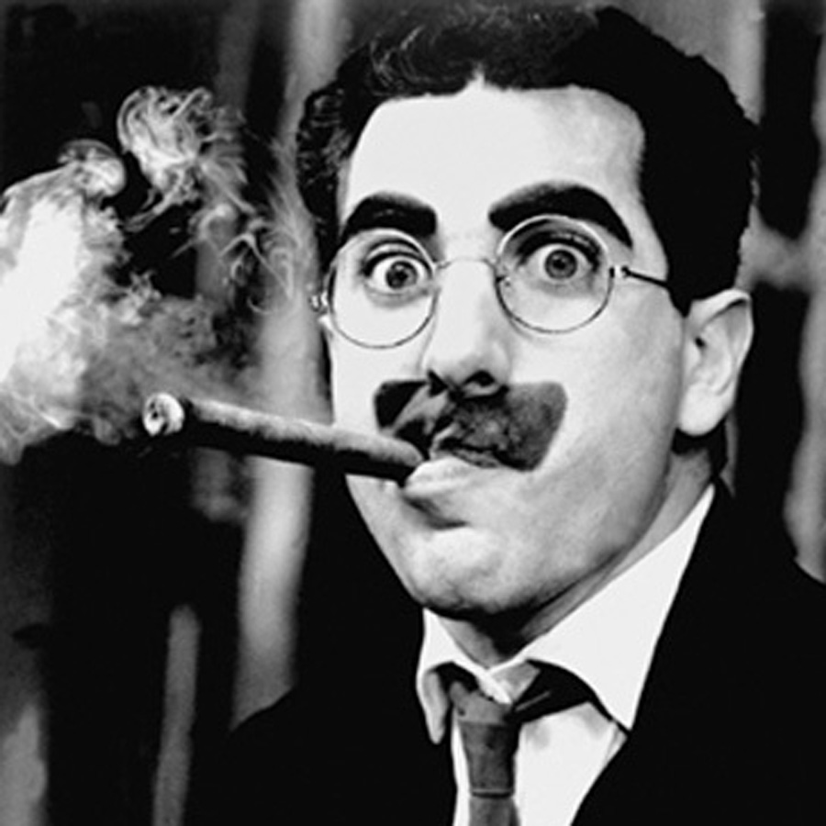
How to parse this sentence?
I shot an elephant in my pyjamas.
(Hint: the next sentence was “how he got into my pyjamas I’ll never know”).

Slide 32
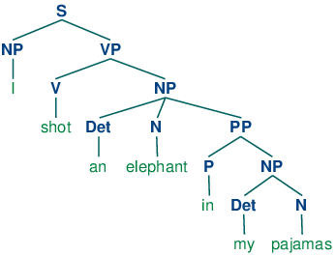
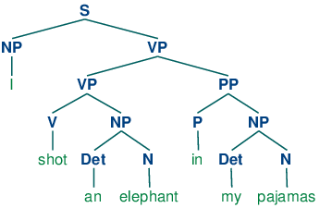
Who was in the pyjamas?

Slide 33
How to parse?
Create probability for each word as a noun, verbs, adjectives, etc.
i.e. Look up a corpus
Assign a probability for each phrase
i.e. Look up a very, very big corpus
Multiply out a lot of big matrices
i.e. Give up when you get something that looks OK
NLTK’s Perceptron tagger does OK at this:
nltk.pos_tag(nltk.word_tokenize(“I bought a frog”))
Google’s Parsey McParseface is the leader

Slide 34
Term Document Frequency
DATA SCIENCE PART TIME COURSE

Slide 35
Latent Dirichlet Allocation
DATA SCIENCE PART TIME COURSE

Slide 36
HOW COULD WE RUN SENTIMENT ANALYSIS?
DATA SCIENCE PART TIME COURSE

Slide 37
EXAMPLE - SENTIMENT ANALYSIS
Most sentiment prediction systems work just by looking at words in isolation, giving positive points for positive words and negative points for negative words and then summing up these points.
Often trained on datasets of measurable positive / negative comments (such as movie reviews)
The order of words is ignored and important information is lost
Better ones identify which topics are being referred to

Slide 38
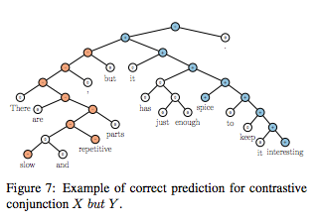
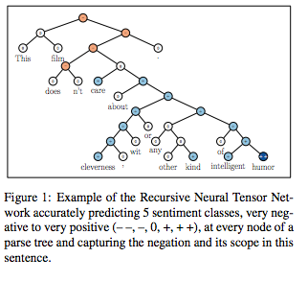
EXAMPLE - SENTIMENT ANALYSIS

Slide 39
Now for the easy version
DATA SCIENCE PART TIME COURSE

Slide 40

2000 Free lookups per day on IBM Watson
Entity Extraction
Sentiment Analysis
Keyword Extraction
Concept Tagging
Relation Extraction
Taxonomy Classification
Author Extraction
Language Detection
Text Extraction
Microformats Parsing
Feed Detection
Linked Data Support

Slide 41
Or…
Request access to the closed beta of Google cloud-text
(And get access to the speech API at the same time)

Slide 42
Or…
import textblob
Text = textblob.TextBlob(“Greg is a nice person.”)
print Text.sentiment, Text.polarity, Text.subjectivity
print Text.parse()
print Text.word_counts
print Text.detect_language()
print Text.noun_phrases
print Text.np_count
print Text.ngrams(2)

Slide 43
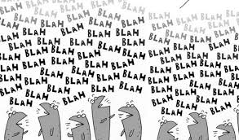
LAB & exit tickets
DATA SCIENCE PART TIME COURSE

